Slide 1
XML request and parser
ENG22CA0012
Eng22ca0017
Eng22ca0024
Eng22ca0057

Slide 2
XML Http Request
All modern browsers have a built-in XMLHttpRequest object to request data from a server.
XMLHttpRequest (XHR) is an API in the form of an object provided by web browsers to interact with servers. It allows for sending HTTP or HTTPS requests to a web server and loading the response data back into the script. This enables web pages to be updated asynchronously by exchanging small amounts of data with the server behind the scenes, making web applications more dynamic and responsive without requiring a full page reload.

Slide 3
The XMLHttp Request Object
The XMLHttpRequest object can be used to request data from a web server.
The XMLHttpRequest object is a developers dream, because you can:
Update a web page without reloading the page
Request data from a server - after the page has loaded
Receive data from a server - after the page has loaded
Send data to a server - in the background

Slide 4
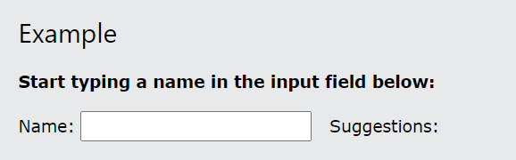
XML Http Request Example
When you type a character in the input field below, an XMLHttpRequest is sent to the server, and some name suggestions are returned (from the server):

Slide 5
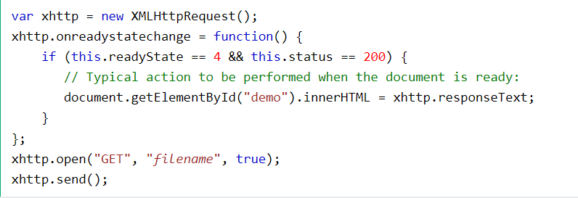
Sending an XMLHttpRequest
A common JavaScript syntax for using the XMLHttpRequest object looks much like this:

Slide 6
XML Parser
The XML DOM (Document Object Model) defines the properties and methods for accessing and editing XML.
However, before an XML document can be accessed, it must be loaded into an XML DOM object.
All modern browsers have a built-in XML parser that can convert text into an XML DOM object.

Slide 7
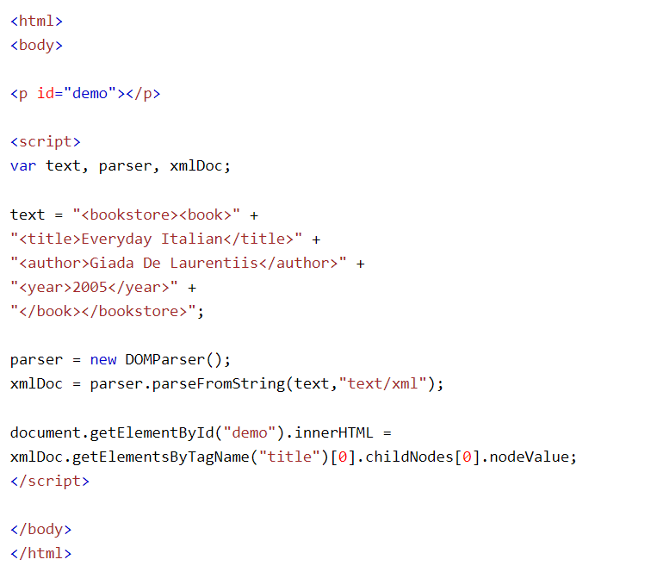
Parsing a Text String

Slide 8
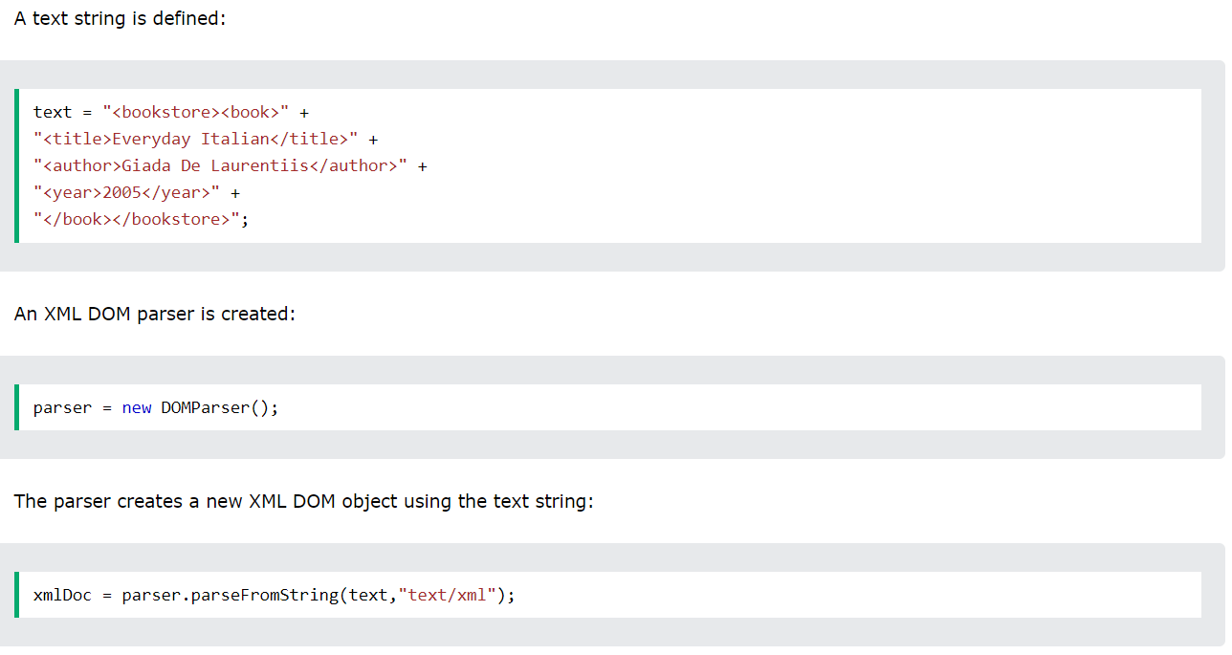
Example Explained

Slide 9
The XMLHttpRequest Object
The XMLHttpRequest Object has a built in XML Parser.
The responseText property returns the response as a string.
The responseXML property returns the response as an XML DOM object.
If you want to use the response as an XML DOM object, you can use the responseXML property.

Slide 10
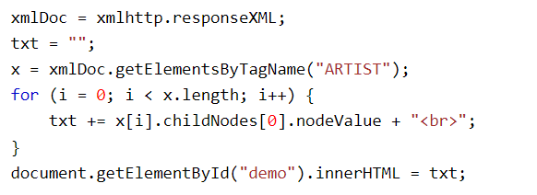
Example
Request the file cd_catalog.xml and use the response as an XML DOM object:

